Slide 1
Comment Feature

Slide 2
Requirement Overview
Update Comment - Add the comment modify feature, the comment owner can modify comment
Delete Comment - Add the comment delete feature, the comment owner and admin user can delete comment
Reply Comment - Anyone can reply to the comment
Redesign Comment – Redesign comment component in front end

Slide 3
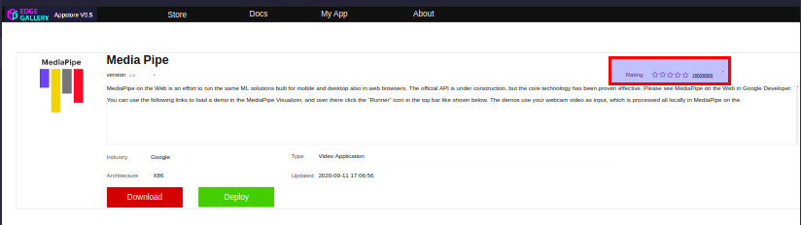
Front-end Overview
Every Application will have reviews button. When it is clicked, review component will be displayed

Slide 4
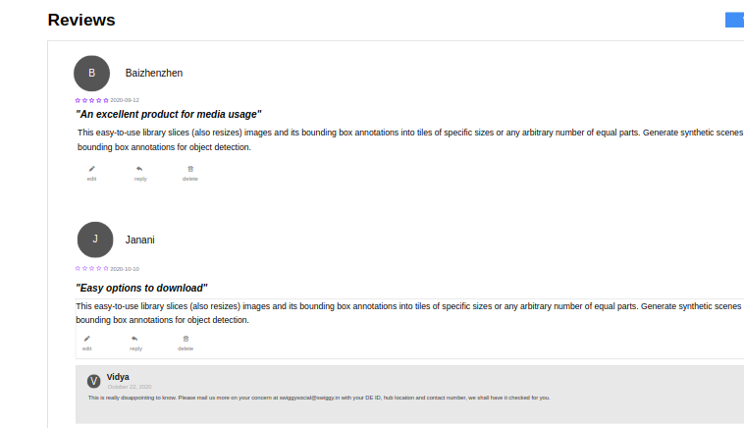
Front-end Overview

Slide 5
Update comment - Add the comment modify feature, the comment owner can modify comment
API: apps/{appId}/comments/{commentId}
Method: PUT
API Param: appId, commentId
Request Param:
userId, userName
Request Body:
body

Slide 6
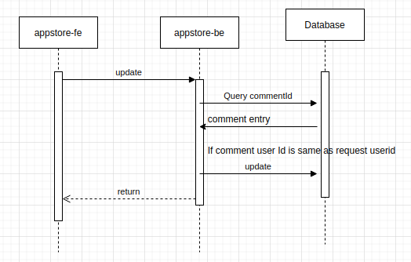
Update comment - Flow diagram

Slide 7
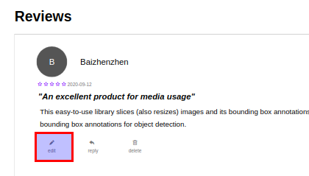
Update comment - UI Change
Add edit button

Slide 8
Delete comment - Add the comment delete feature, the comment owner and admin user can delete comment
API: /apps/{appId}/comments/{commentId}
Method: Delete
API Param: appId, commentId
Request Param: userId, userName

Slide 9
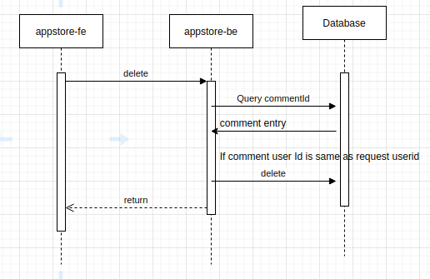
Delete comment - Flow diagram

Slide 10
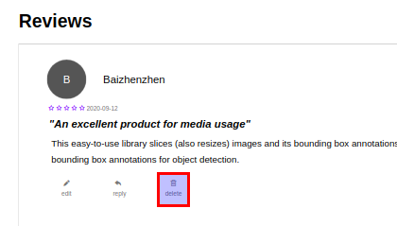
Delete comment - UI Change
Add delete button

Slide 11
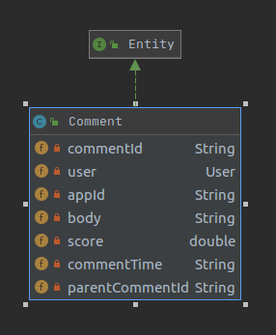
Comment reply
Add new field parentCommentId in csar_package_score table

Slide 12
Comment reply - API
2. Define new api for comment reply
API: /apps/{appId}/comments/{commentId}/reply
Method: POST
API Param: appId, commentId
Request Param: userId, userName
Request Body: String

Slide 13
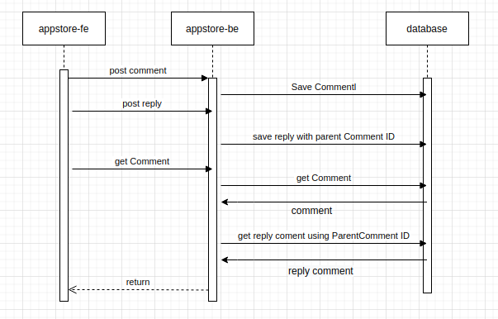
Comment reply - flow diagram

Slide 14
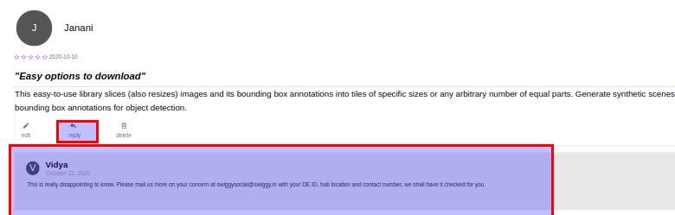
Reply comment - UI Change
Add reply button & text box for reply

Slide 15
Security Considerations
Content | Related Information
Security design rule ID | 1.1，1.2，1.3，8.1，9.2，9.3，9.4
Implementation details | Interface authentication Param validation Document description of resultful interface Logging without sensitive information and log security
Related APIs | PUT /apps/{appId}/comments/{commentId} DELETE /apps/{appId}/comments/{commentId} POST /apps/{appId}/comments/{commentId}/reply
Example API payload | Refer to api analysis
Related files | CommentService.java in backend & comment related components in UI
Related GUI URLs | undetermined
GUI testing steps | Click on edit button to update comment Click on reply button to reply to comment Click on delete button to delete a comment
GUI input example | Click on edit/reply/delete button

Slide 16
Thank you

